Slide 1

Hospital Manager project
Samuel Ying
Northeastern University College of Engineering Department of Electrical and Computer Engineering EECE 2560: Fundamentals of Engineering Algorithms Fall 2024

Slide 2

Introduction
This project aims to design a hospital emergency room patient management system that prioritizes patients based on their medical condition severity and time spent waiting. The system uses priority queues to ensure that patients in critical condition are treated first while also accounting for patients with extended wait times.
Developing a priority queue-based patient system.
Balancing patient severity and wait time to ensure equitable care.
Automating patient prioritization for improved ER efficiency.

Slide 3
Literature review
Explored the development of a sophisticated hospital patient management system.
Gained experience with frameworks for building standalone applications, including:
Spring Boot for backend logic.
Angular for frontend user interface.
Based on a project that implemented backend and frontend for an employee manager.
Adapted the system to implement priority queues, enabling dynamic patient prioritization and efficient queue management.

Slide 4
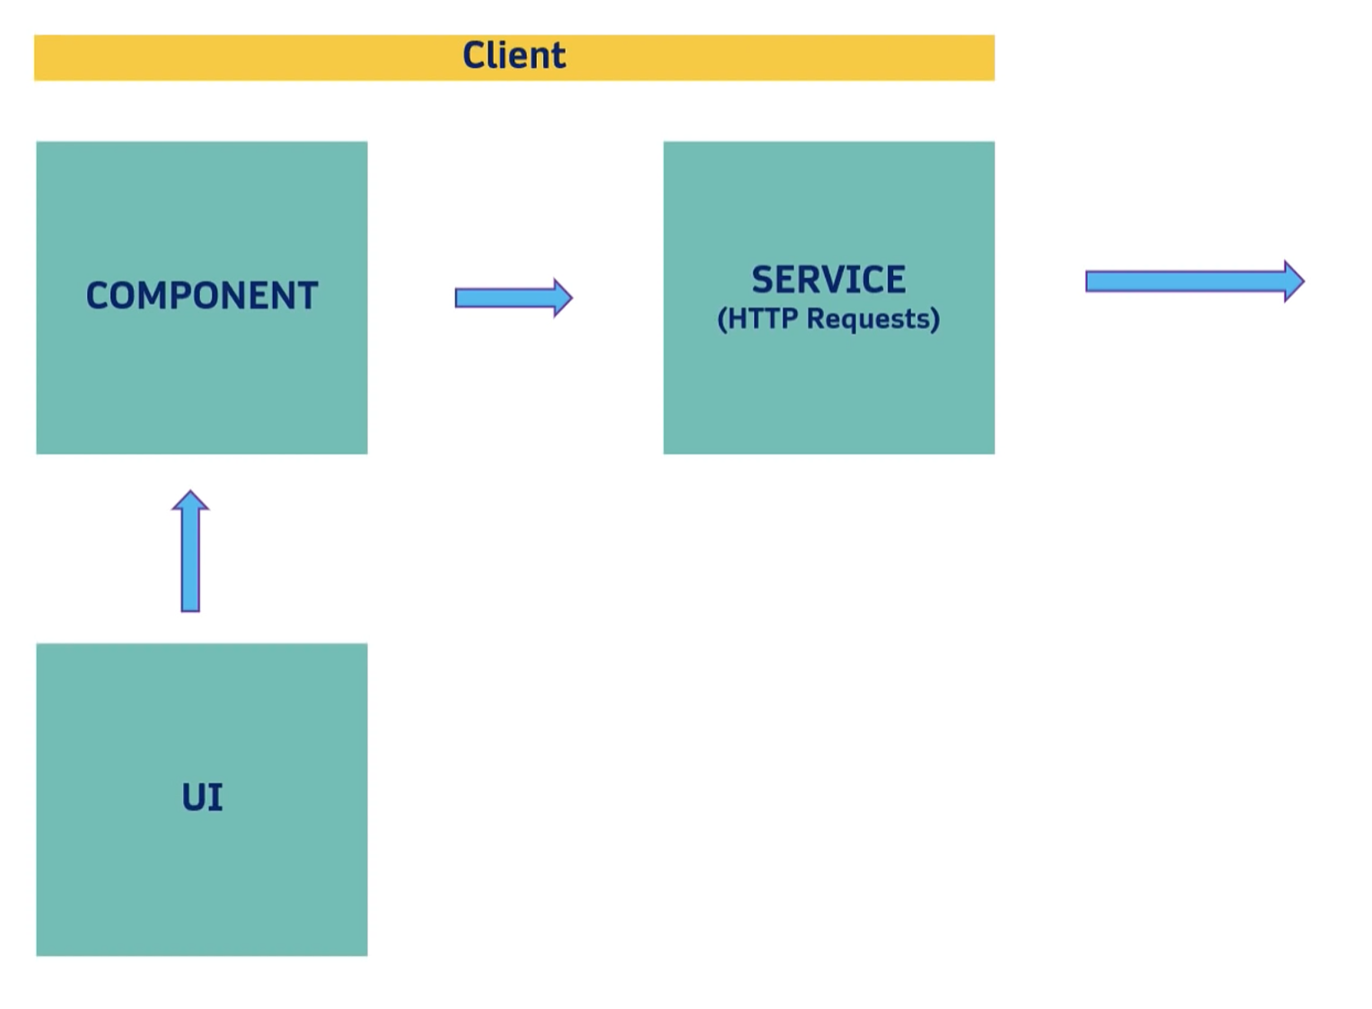
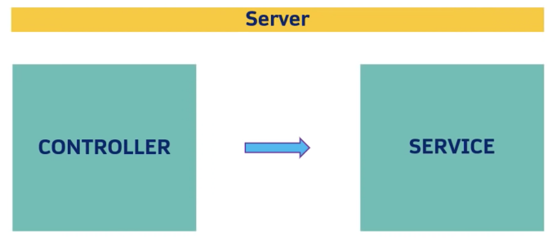
Spring Boot
Methodology
Angular

Slide 5
Methodology
Patient priority determined by custom priority queue
Time Complexity:
Add: O(log n)
Get Next: O(log n)
Delete: O(n)
Peek: O(1)

Slide 6
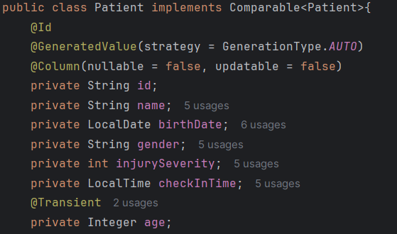
Methodology
Pseudocode:
FUNCTION compareTo(Patient p)
DEFINE wait time threshold as 15 minutes in seconds
CALCULATE the wait time for the current patient: timeNow - checkInTime
CALCULATE the wait time for the other patient: timeNow – checkInTIme
SET current and other patient priorityScore as their injurySeverity
IF the current patient's wait time exceeds the threshold THEN
ADJUST their priority score:
Increase the severity score slightly and multiply by their wait time
IF the other patient's wait time exceeds the threshold THEN
ADJUST their priority score:
Increase the severity score slightly and multiply by their wait time
IF current and other patient priorityScore equals
Return result where patient with longer watiTime has higher priority
COMPARE the adjusted priority scores:
Return result where the patient with the higher score has higher priority
END FUNCTION

Slide 7
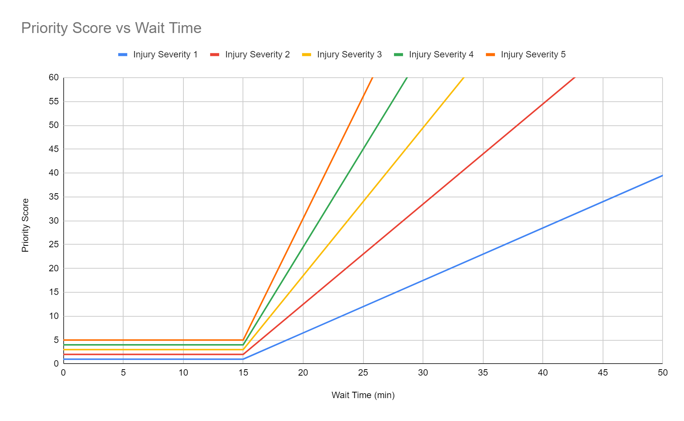
Analysis and results
Graph
Hours spent:
Weekly: ~5 hours
Month: ~25 hours
Key Findings:
Efficiently managed dynamic patient prioritization
Reduced wait times for critical patients

Slide 8
Demonstration

Slide 9
Discussion
Implications of Findings:
Demonstrated feasibility of priority queue systems in hospital ER management.
Provided a framework for scalable ER management systems.
Project Limitations:
Limited time and testing.
Requires hospital personals to assess injury severity.

Slide 10
Conclusion
Conclusions from the Project:
Priority queue is an effective data structure for hospital ER management.
Successfully combined backend and frontend frameworks for a functional system.
For future work:
Make priority queue output actual exact order of patients in queue and not just estimate of where patients are.
Considering not using binary heap though might have slower time.
Use a database so that even if backend goes down, the patient data would be saved.

Slide 11
references
Spring Boot: https://www.youtube.com/watch?v=9SGDpanrc8U&list=PLwvrYc43l1MzeA2bBYQhCWr2gvWLs9A7S&index=10
Angular: https://www.youtube.com/watch?v=Gx4iBLKLVHk&list=PLwvrYc43l1MzeA2bBYQhCWr2gvWLs9A7S&index=13
UI template using Bootstrap: https://www.bootdey.com/snippets/view/bs4-contact-cards#html

